Slide 1
The Criminal Justice Research Center
Helping communities through research and policy
Jeffery Ulmer, Center Director

Slide 2
The Center’s Mission, est. 2009
The Penn State Criminal Justice Research Center:
bridges the gap between research and practice,
fosters a rigorous research agenda that advances criminological theory and criminal justice policy, and
transfers criminological knowledge into the practitioner and policy communities.

Slide 3
The Center:
Is located within the PSU College of the Liberal Arts
Supports faculty, graduate, and undergraduate research
Connects scholars to agency partners and vice versa
Supports undergrad student enrichment (internships, research, and employment opportunities)
Center funding comes from:
College of Liberal Arts (general budget)
External grant support
MOU with PA Sentencing Commission
Postdoc funding from PADOC
SSRI/CCSA support

Slide 4
Connecting the Criminal Justice Community
Agency Partners
Community/Alumni
Academic
Discipline
Criminal Justice Research Center
External to PSU
Internal to PSU
Faculty
Graduate Students
Criminology Undergraduates

Slide 5
The CJRC Advisory Board
Composition: Agency Partners, Alumni Representatives, Academic Administrators, Commonwealth Campus Representative
Goals:
Provide feedback for center strategic planning
Communicate CJRC initiatives and research to outside stakeholders
Strengthen existing collaborations
Provide access for future research, data sharing, funding opportunities
Assistance in project proposal evaluations
Widen CJRC impact

Slide 6
Advisory Board Members
Michelle Frisco, Head of the Department of Sociology and Criminology, Professor of Sociology & Demography
Scott Bennett, PSU Representative, College of the Liberal Arts Associate Dean for Research, Distinguished Research Professor
Bret Bucklen, Agency Partner, Research Director, Pennsylvania Department of Corrections
Deborah Ehrenthal, PSU Representative, Director, Social Science Research Institute (SSRI) Professor, Biobehavioral Health
Bryanna Fox, Associate Professor in the Department of Criminology at the University of South Florida
Shaun Gabbidon, Distinguished Professor of Criminal Justice
Matthew Kleiman, Agency Partner, Deputy Director of the Pennsylvania Commission on Sentencing
Derek Kreager, Liberal Arts Professor of Sociology and Criminology, Center Director from July 2017 to June 2021
Stephanie Lanza, PSU Representative, Director, The Edna Bennett Pierce Prevention Research Center, Professor, Department of Biobehavioral Health, Consortium on Substance Use and Addiction
Michael Light, Professor of Sociology and Chicano/Latino Studies at the University of Wisconsin-Madison
Ricardo Nunez, Alumni Representative, Administration of Justice ‘79
Glenn Sterner, Commonwealth Campus Representative, Assistant Professor of Criminal Justice, Abington, Criminal Justice Research Center Postdoctoral Scholar Alumni
Michael Wagner, Alumni Representative, Administration of Justice

Slide 7
Personnel (2023)
Jeffery Ulmer
Joy Vincent-Killian
Megan Kurlychek
Director
Outreach/Enrichment
Associate Director
TBD
Gary Zajac
Communications Intern
Managing Director
Shared with Dept
Center Post-Doctoral
Scholar
Center Researchers
Center Graduate
Assistants
PA Department of
Corrections
PA Commission on
Sentencing
Administrative
Services
Vacant
Elaine Arsenault
Yiwen Zhang
Mike LaForest
Laura Beckman
Stacey Lyons
Post-Doctoral Scholar
Visting Scholar
Administrative Support Coordinator
(UP)
Sam Nur
Julia Dillavou
Dorothy Du
Helen Pawko
Post-Doctoral Scholar
Administrative Assistant
(Abington)
Jeremy Staff
Jennifer Maggs
Gillian Russell
C.P. Thomas
CLA 2019
Faculty Advisors
Post-Doctoral Scholar
Emerson Waite
Glenn Sterner
Graduate Assistant
Supervisor

Slide 8
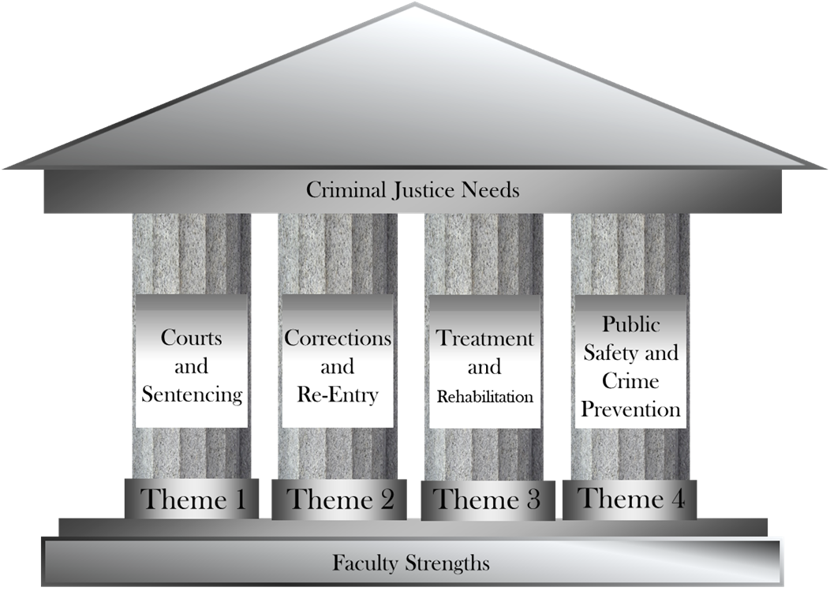
Center Themes (2023)

Slide 9
CJRC Faculty Seed Funding
Assist PSU faculty (UP and Campuses) research
Research connects to CJRC themes
Typically up to $7500. Uses can include:
Personnel/consultant wages or support
Pilot data collection
Faculty time

Slide 10
CJRC Seed Funding Mechanism
Timeline
Fall Round:
July 1 – Release Solicitation
August 30 – Proposals Due
September – review proposals, inform applicants by mid-month to meet October 1 deadline for course releases
Spring Round:
December 1 – Release Solicitation
January 30 – Proposals Due
February - review proposals, inform applicants by mid-month to meet March 1 deadline for course releases

Slide 11
C3N Seed Funding
C3N initiative funded by OSVPR to support the development of research agendas among faculty at the Commonwealth Campuses
CJRC manages the Criminal Justice node of C3N
Gave four new awards to Commonwealth Campus faculty in 2022

Slide 12
Post-Doctoral Research Positions
CJRC:
supports one fixed-term renewable position for support of specific faculty mentor’s project(s) with high probability for future growth and funding
PCS:
Supports two postdoctoral scholars to work on PCS mandated research, collaborative research on issues of interest to PCs and scholars
PA DOC:
Supports one postdoctoral scholar to work on research of PA DOC interest.

Slide 13
Speaker Series Overview Flyer
CJRC Speaker Series Spring 2023
CJRC Speaker Series Fall 2022
CJRC Speaker Series Spring 2022

Slide 14
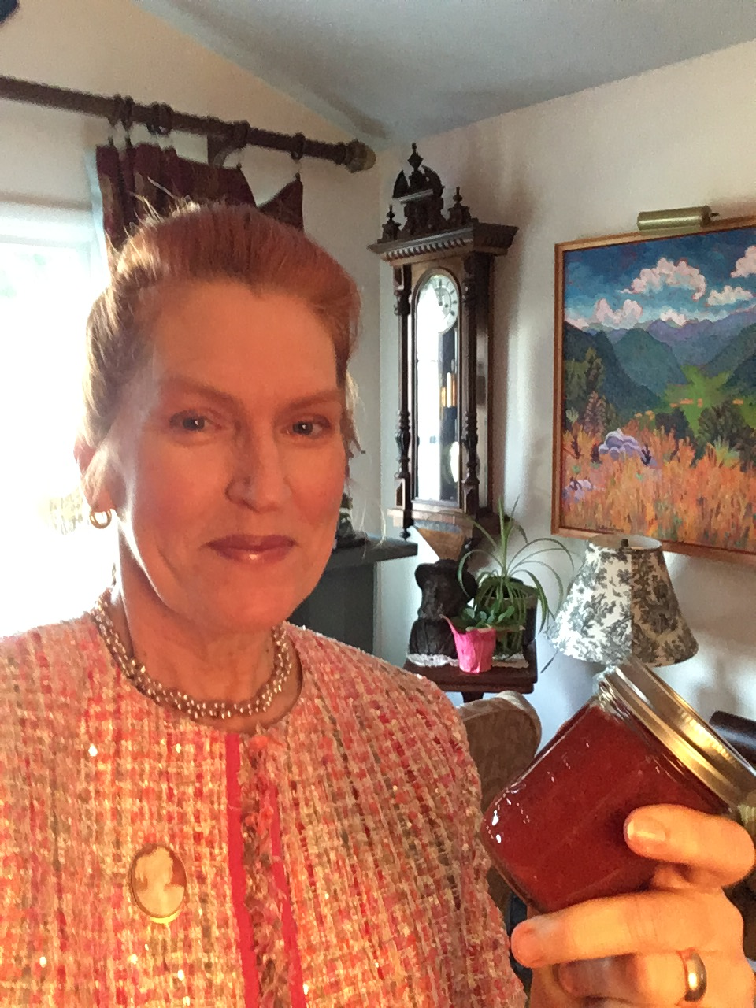
Outreach and Enrichment
Expanding Center Capacities
Internship management
Undergraduate students/Agencies/Career Enrichment Network
Research Assistant marketing, intake interviews and placement matching with faculty
Promotion of criminal justice research and events
Advisory Board planning, coordination and implementation
Fall Career Expo prospecting new vendors, promotion, logistics, and on-site management
Criminology Speaker Series planning, coordination and marketing
Joy Vincent-Killian

Slide 15
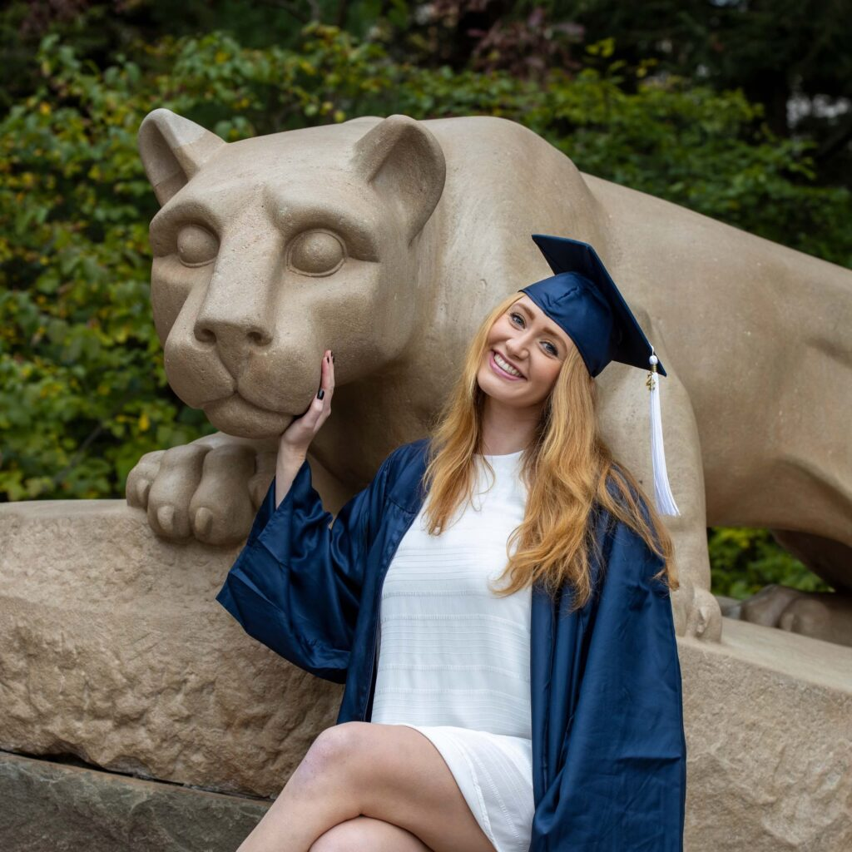
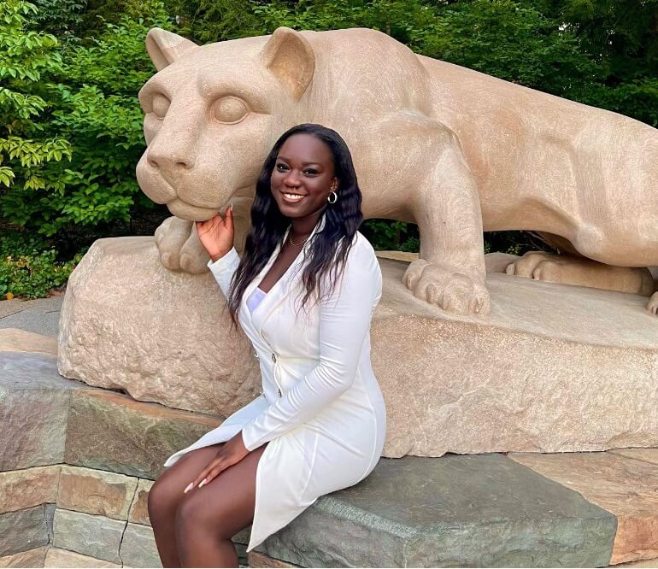
Undergraduate Research Assistants
“Working as an assistant researcher for Dr. Ulmer, Dr. Zajac, and the Criminal Justice Research Center has been an immensely academically enriching experience that I would recommend to any student with interest in real world application of Criminology and Criminal Law.”
“I started this research as an undergrad, and it played a huge role in my overall reasonings for wishing to attend law school to obtain my J.D. I hope to use my J.D. to enable the much-needed change in our Criminal Justice System.
It has been a blessing to be able to be a part of the projects I have worked on and be able to use them to spread awareness and advocate for Criminal Justice Reform as well as apply them to my future career goals.”
Sydney Harris
Spring 2022 Graduate
Tiffeny Ayoola
Spring 2022 Graduate

Slide 16
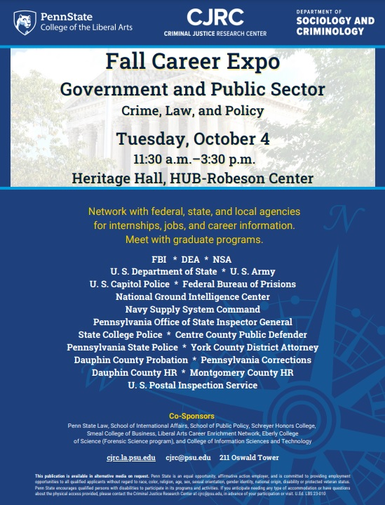
The Criminal Justice Career Expo took place on October 4th in the HUB-Robeson Center’s Heritage Hall. Nearly 40 agencies and vendors meet with 321 students. Vendors who arrived early to set up found a line of eager students attend. Over half of the students were from criminology with many of their professors coming to see the packed room. The strong collaboration across Penn State coupled with our champion faculty was evident in our high attendance of 321 students, 63% College of the Liberal Arts, 19% Eberly College of Science, and 5% College of Information Science and Technology. Forensic Science Program Director Dr. Jason Brooks was a champion faculty member who heavily promoted the expo in Eberly College of Science. Student majors were comprised of: 52% criminology, 18% Liberal Arts and 13% forensics science.

Slide 17
Fall Career Expo
Walking into Heritage Hall, the view was of Federal, State, and local uniformed law enforcement, lawyers from county courts, and county human resources throughout the state. Long lines formed at NCIS (Naval Criminal Investigative Service), DEA, and FBI with at times 10 to 18 students deep.
Representatives from several county criminal justice agencies commented on the interest at their tables and the well prepared and professional attire, noting that this was “very rare, and very impressive!” Some counties had as many as four tables with recruiters from multiple agencies.
As the afternoon wrapped up, employers told CJRC staff this was by far the best career fair they had registered for in three years. The recruiters stated that our expo had many candidates in their specific field and produced many applications for their positions. All agencies and vendors said they were looking forward to fall 2023 and would be encouraging friends and colleagues in criminal justice to participate.

