Slide 1

Initiatives and Opportunities in the
Criminal Justice Research Center
October, 2019
Dr. Derek Kreager
Director, Criminal Justice Research Center

Slide 2

The CJRC Mission
Bridge the gap between research and practice
Foster a rigorous research agenda and externally-funded grants portfolio
Engage government and community partners
Transfer criminological evidence to practitioner and policy communities
Center Funders
College of Liberal Arts (general budget)
External grant support
MOU with PA Sentencing Commission
SSRI/CCSA support

Slide 3


Organizational Chart
Derek Kreager
Rebecca Reitz
Director
Outreach/Enrichment
Gary Zajac
Managing Director
Center
Post-Doctoral Scholar
Center Researchers
Center Graduate
Assistants
PA Department of Corrections
PA Commission on Sentencing
Administrative
Services
Jonathan Dirlam
Elaine Arsenault
Ted Greenfelder
TBA
Lindsay Bostwick
Sharon Laskowsky
Post-Doctoral Scholar
Post-Doctoral Scholar
Administrative Assistant (UP)
Sam Nur
Julia Dillavou
Miranda Galvin
Dennis Dozier
Post-Doctoral Scholar
Administrative Assistant
(Abington)
Kim Davidson
Eric Baumer
Graduate Assistant
Jordan Zvonkovich
Faculty Advisor
Graduate Assistant

Slide 4
Organizational Chart
Derek Kreager
Rebecca Reitz
Director
Megan Kurlychek
Outreach/Enrichment
Gary Zajac
Associate Director
Managing Director
Center
Post-Doctoral Scholar
Center Researchers
Center Graduate
Assistants
PA Department of Corrections
PA Commission on Sentencing
Administrative
Services
Jonathan Dirlam
Elaine Arsenault
Ted Greenfelder
TBA
Lindsay Bostwick
Sharon Laskowsky
Post-Doctoral Scholar
Post-Doctoral Scholar
Administrative Assistant (UP)
Sam Nur
Julia Dillavou
Miranda Galvin
Dennis Dozier
Post-Doctoral Scholar
Administrative Assistant
(Abington)
Kim Davidson
Eric Baumer
Graduate Assistant
Opening Spring, 2020
Jordan Zvonkovich
Faculty Advisor
Graduate Assistant

Slide 5
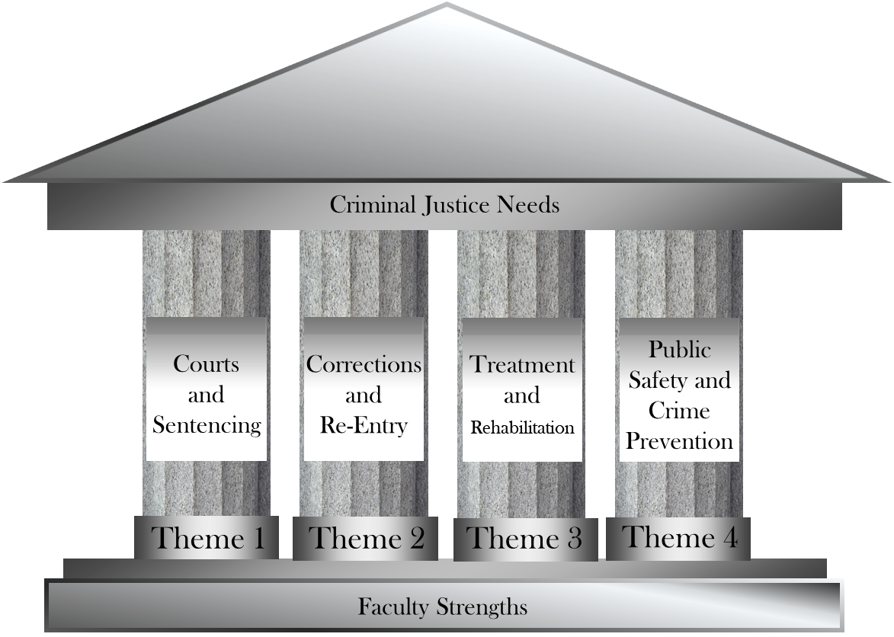
2019 Center Themes

Slide 6
2019 Center Themes
Advisory Board
Recommended Change
Previously “Substance
Abuse and Treatment”
and “Policy and
Evaluation”

Slide 7
Linking PSU to the Criminal Justice Community
Agency Partners
Community
Academic
Discipline
CJRC
External
PSU
Faculty
Graduate
Students
Criminology
Undergraduates

Slide 8
Linking PSU to the Criminal Justice Community
Agency Partners
Community
Academic
Discipline
CJRC
External
PSU
Faculty
Graduate
Students
Criminology
Undergraduates

Slide 9
Faculty Seed Funding
Assist PSU faculty (UP and Campuses) research
Connect to CJRC themes
$500-$5000 (or one faculty course buyout at $7500 rate)
  Personnel/consultant wages or support
  Pilot data collection
  Faculty time
  Project meetings or conferences
http://justicecenter.la.psu.edu/faculty-resources/center-seed-funding
Expect to fund 3-4 proposals
Affiliations with SSRI/PRI/CCSA are supported
Deadline 25 Oct, 2019

Slide 10
2018 Seed Grant Awards
Illuminating the Opioid Drug Crisis in Pennsylvania: Trends, Patterns, and Correlates of Drug and Opioid Law Violations across Rural and Urban Pennsylvania Counties from 2000 to the present
Drs. Darrell Steffensmeier and Jeffery Ulmer (Professors of Sociology and Criminology)
Mechanisms of Firearm-Related Family Violence
Dr. Amy Marshall (Associate Professor of Psychology)
The Ethics of Policing Conference
Dr. Eduardo Mendieta (Associate Director of the Rock Ethics Institute)
Effects of Permanency on the Adult Criminality of Former Foster Care Youth
Dr. Sarah Font (Assistant Professor of Sociology)
Linking Accidental Overdoses to Medical Professionals and Pharmacies: A Population-Based Social Network Analysis
Drs. Oren Gur and Glenn Sterner (Assistant Professors of Criminal Justice, PSU Abington)

Slide 11
Post-Doctoral Research Position
Fixed-term renewable position for support of specific faculty mentor’s project(s) with high probability for future growth and funding
1-2 year term
2018-20 post-doc (Jonathan Dirlam-OSU) supported Dr. Eric Baumer
Current proposals accepted until Oct 18th for 2020-22 term
Contact Derek Kreager (dak27@psu.edu) with any questions

Slide 12
Linking PSU to the Criminal Justice Community
Agency Partners
Community
Academic
Discipline
CJRC
External
PSU
Faculty
Graduate
Students
Criminology
Undergraduates

Slide 13
Graduate Research Award
Goal: Support promising graduate student research (MA or Phd)
in the area of criminal justice.
Award: $2000 summer funding typically for two students (1 CJRC, 1 PCS)
Application details released Fall, 2019, with a deadline of Jan 2020.
Awardees will present their research in a criminology forum.
Current Award Winners:
Rebecca Bucci, “Closing the Macro-Micro Link: Deterrent Effects on
Individual Substance Use & Offending”
Ted Greenfelder, “Outcomes from the Prison Inmate Networks Study:
Re-Entry and Recidivism”
John Crum, “Punitive Heroin Laws”

Slide 14
Linking PSU to the Criminal Justice Community
Agency Partners
Community
Academic
Discipline
CJRC
External
PSU
Faculty
Graduate
Students
Criminology
Undergraduates

Slide 15
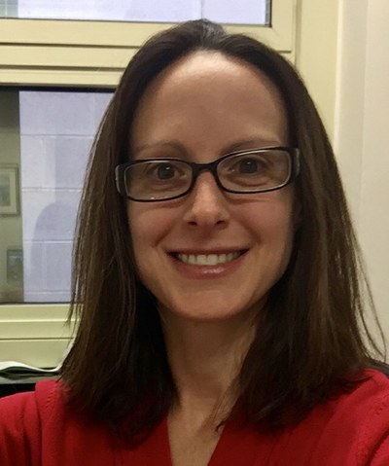
Outreach-Enrichment Coordinator Position
Expanding Center Capacities
  Internship coordination (Agencies/Alumni/Career Enrichment Network)
  Promotion of criminal justice research and events
  Advisory board coordination and activities
  Yearly career fair
  Criminology Forum promotion
Rebecca Reitz

Slide 16

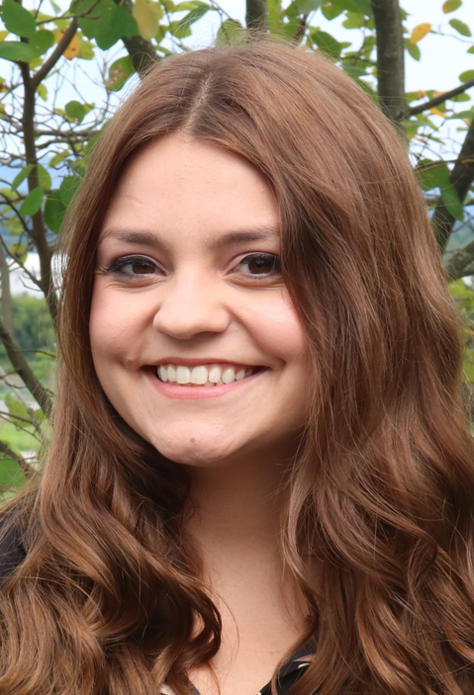
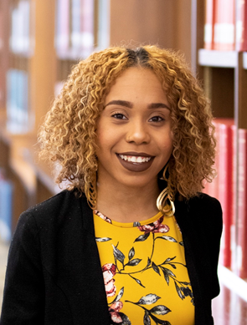
Undergraduate Research Assistants
Rebecca can help identify qualified and motivated RAs.
“Completing research with Dr. Ulmer has been a great opportunity…Being able to work with a faculty member and gain insight into a new subject matter- death penalty research- has been invaluable.”
“I was able to conduct research through the McNair Scholars Program with Dr. Kreager to analyze the role that fatherhood may play in the reentry process for men with substance abuse issues.”
Erin Doolin
Spring 2020 Graduate
Chanya Anderson
’19 PSU Graduate &
UDel Crim Grad Student

Slide 17

Crime, Law, and Policy Career Fair

Slide 18
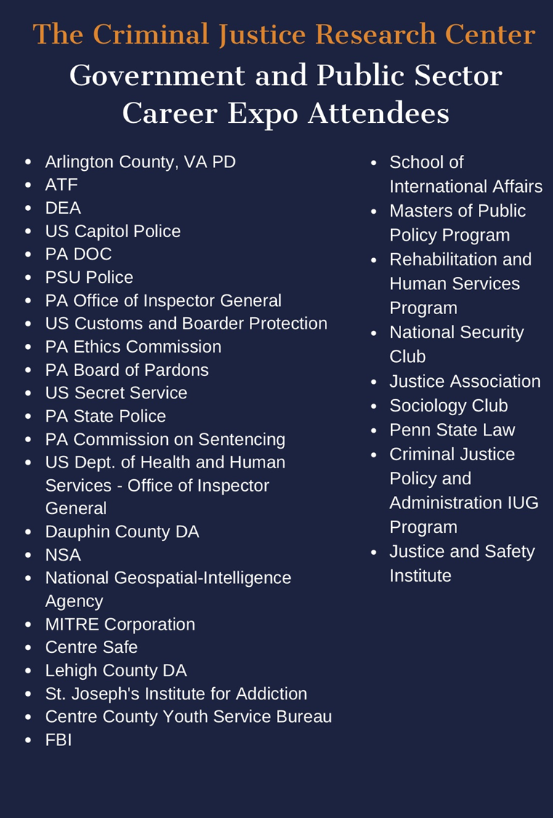
More than 30 Agencies and Organizations
https://justicecenter.la.psu.edu/outreach-enrichment

Slide 19
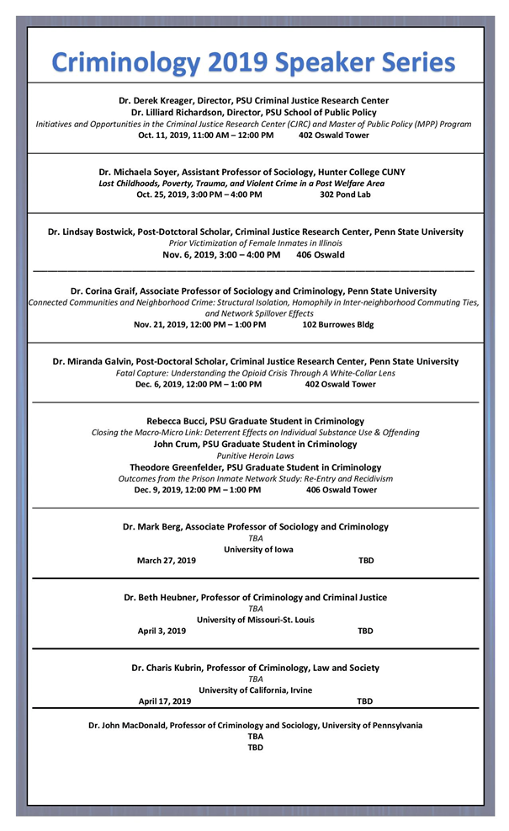
2019 Crim Forum Series
Megan Kurlychek will
chair these activities in 2020
A Qualtrics survey will go out in Spring 2020

Slide 20
CJRC Advisory Board
Agency Partners
Bret Bucklen - PA Dept Corrections
Maj. Pat Brinkley - PA State Police
Mark Bergstrom- PA Comm Sentencing
PSU Representatives
Eric Baumer – Soc/Crim Head
Susan McHale – SSRI Director
Scott Bennett – CLA Assoc Dean Res
Student Representatives
Kim Davidson – Graduate Rep
Justice Assoc President
Alumni Representatives
John Kramer – Emeritus Fac
Michael Wagner
Ricardo Nunez
External Academics
Candace Kruttschnitt (UTor)
Dana Haynie (OSU)
CJRC Representatives
Derek Kreager – Director
Megan Kurlychek – Assoc Director
Gary Zajac – Managing Director
Glenn Sterner – Campus Rep

